Slide 1
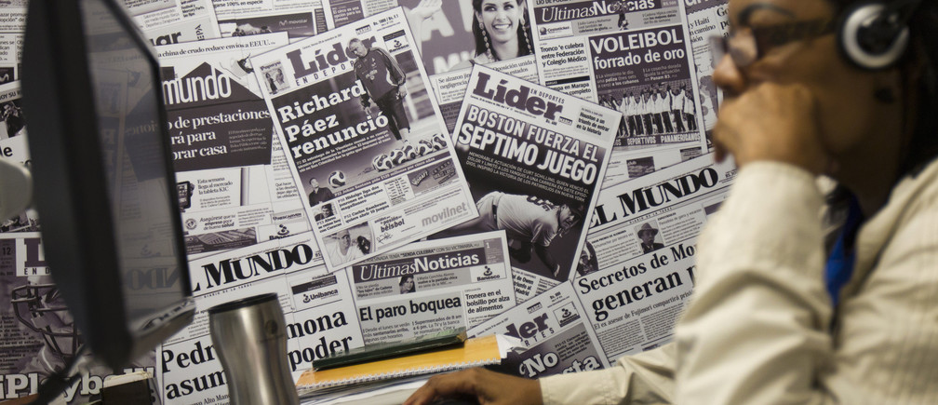
Topic:
JORNALISM IS A WEAPON AGAINST CORRUPTION
Submitted to
SHAILA AHMED
Senior Assistant Professor
Dept. of English AIUB
Presented by group: 2
SM Walid 23-50005-1
Kawsar Khan 23-50192-1
Abir Tirtha Das 23-50228-1
Farhan shahriar Joy 23-50306-1
Abu Bakkar Siddik 23-50049-1

Slide 2

JOURNALISM
What is Journalism.
First rough draft of history.
Journalism is the fourth pillar of democracy.

Slide 3

Broadcast Journalism.
Digital Journalism.
Sports Journalism.
CLASSIFICATION

Slide 4
EFFECTS OF CORRUPTION
Public frustration and cynicism.
Impunity and partial justice.
Organized crime and terrorism.

Slide 5
ADVOCACY AND AWARENESS RISING BY
JOURNALISM
Share quality report not quantity.
Diversify the news consumption.
Become an advocate.
Press

Slide 6

USE OF JOURNALISM TO PROTEST
CORRUPTION
Investigative Journalism
Importance Of Investigative Journalism
Whistle Blower Protection

Slide 7

Panama Paper
Watergate Scandal
Role Of Investigative Journalism
CASE STUDIES​

Slide 8

RISK INVOLVED IN EXPOSING CORRUPTION
Physical risk.
Cyber attacks.
Reputational damage.

Slide 9

TRANSPARENCY AND ACCOUNTABILITY OF JOURNALISM
Clean source.
Fact checking.
Report or news corrections.

Slide 10
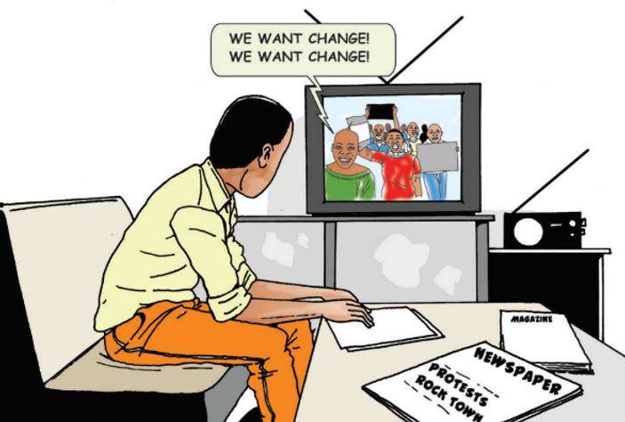
PUBLIC ASSURANCE
Verification of information before publishing to build public trust.
Avoidance of prejudice and sensationalism to deliver balanced news.
Upholding ethical standards for promoting the public interest.

Slide 11
OUTCOME OF ALL EFFOTS
Exposure of the money laundering of p.k Hawladar.
Portrayal of the Russo-Ukrainian war.
Exposure of irregularities and corruption in the Bangladeshi health care sector during the COVID-19 pandemic.

Slide 12
Do You have any questions?

